Slide 1
Clusterization in Latvia
Armands Lejas-Krūmiņš

Slide 2
Latvian Cluster Network
Main objective is to strengthen Clusters in Latvia.
Common activities:
Development of Latvian Cluster Network
Representation of Latvian Clusters at national and international level
Join to European Cluster Alliance
Promoting cooperation between Clusters in Latvia
Develop common initiatives, projects and events at Latvian and International level
Strengthen cooperation and coordinated actions for Cluster development in Latvia
Representative of the Latvian Cluster Network – Armands Lejas-Krumins armands.lejas-krumins@lpuf.lv

Slide 3
Industry Summary
Clusterization in Latvia started in 2012 with National Clusters support programme
Latvian Cluster Network was founded on 1st July 2019
Members – 14 clusters
Totally in Latvia – 16 clusters
Total number of members – 580
Total turnover in 2018 –
1 762 000 000 EUR
Total export –
610 000 000 EUR

Slide 4
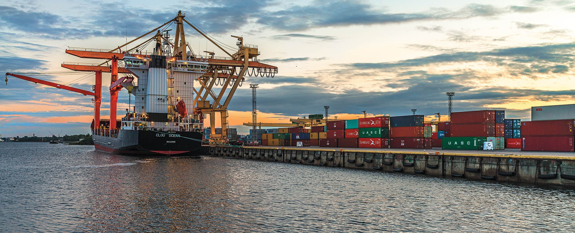
Latvian exports rise by an average of 7% a year in recent years.
At the same time, export turnover in Latvian Clusters is growing almost twice – by 13%.

Slide 5
In 2018, all clusters together provided consultations
for 28 711 hours
It's enough to get around the globe with its feet nearly 4 times!

Slide 6
Latvian Clusters in Numbers (2017)

Slide 7
Latvian National EU programms connected with Clusters
This is not an official opinion of Latvia, but a user's opinion
Ministry of the Economics of Latvia has done a great job supporting the Clusters – National Cluster Programme
Main support to main sectors (IT, Agro-Food, Electronics, Forestry, Metalworking, Chemistry and Pharmacy) and cross-sector (Smart City, Cleantech)
National Cluster Programme supports sector Clusters and cross-sector Clusters:
export missions;
common research for all the sector or subsector;
cooperation with educational establishments;
other.

Slide 8
Latvian National EU programms connected with Clusters
Support for new products and technologies development in Competence Centers
Aim of the program - To increase the competitiveness of merchants by promoting cooperation between the research and industry sectors in the implementation of industrial research, new product and technology development projects
Funding is provided to implementers of individual research and cooperation research projects:
For industrial research;
For experimental development;
For feasibility study for research projects total over EUR 250 000.

Slide 9
Competence Centers
The industry, together with the Ministry of Economy, is preparing financing decisions
Advantage to cross-sectoral projects
Advantage to products with higher export potential
Sinergy between National Clusters programme and Competence Centers programme

Slide 10
Total project costs: 4 898 020.74, including ERDF support 2 990 156.29 EUR, private funding 1 907 864.45 EUR.
Project duration: 01.09.2016-31.12.2018
Achieved indicators:
supported projects – 30
supported enterprises – 30
developed new technologies – 23
developed new products – 182.
Latvian Food Competence Center

Slide 11
Thank you
Armands Lejas-Krumins
armands.lejas-krumins@lpuf.lv
+371 29236363

