Slide 1
Spanish Clusters boosting intelligent business ecosystems

Slide 2
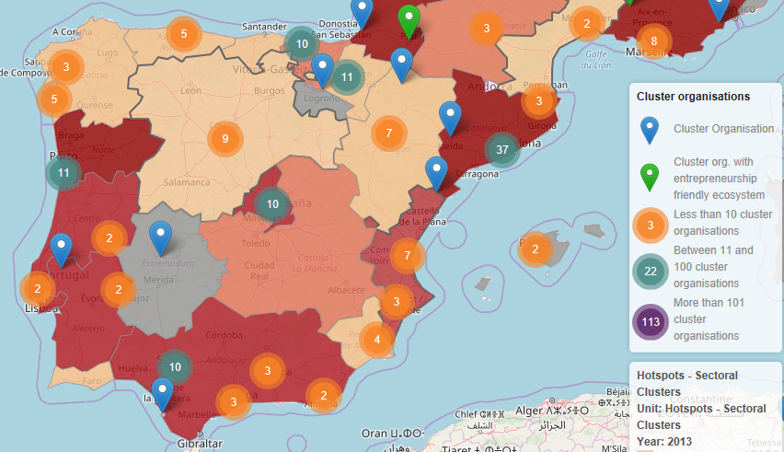
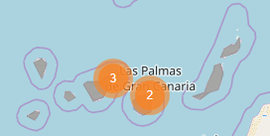
Spanish Clusters: 143 in the ECCP

Slide 3
Spanish AEIs - December 2019
SECTOR | AEIs | Enterprises | SMEs (84%) | Technological Centers | Employees
Aeronautical | 4 | 177 | 127 | 15 | 66.643
Agrifood | 10 | 640 | 519 | 54 | 177.043
Automotive | 6 | 384 | 226 | 16 | 109.584
Biotechnology and Health | 3 | 176 | 150 | 16 | 117.320
Sports | 2 | 139 | 119 | 9 | 16.602
Habitat | 5 | 469 | 450 | 8 | 34.331
Childhood and Toys | 2 | 88 | 77 | 7 | 14.474
Logistics | 4 | 238 | 160 | 17 | 132.833
Industrial Machinery and Technology | 9 | 629 | 540 | 23 | 96.441
Materials | 4 | 342 | 261 | 14 | 78.540
Media | 3 | 108 | 96 | 8 | 18.318
Environment and Energy | 11 | 905 | 736 | 63 | 344.895
Naval | 2 | 243 | 209 | 7 | 75.436
Optics | 1 | 68 | 62 | 21 | 13.854
Textile and footwear | 2 | 195 | 179 | 4 | 13.163
ICT | 11 | 1.681 | 1.541 | 49 | 390.787
Tourism | 3 | 188 | 170 | 5 | 33.360
TOTAL | 82 | 6.670 | 5.622 | 336 | 1.733.624
Spanish AEIs
Registered by the Ministry of Industry
Around 9.000.000€ / year
Priorization on Industry 4.0
Support for:
Launching of AEIs
Technical feasibility studies
Innovation projects
Collaborative projects intra or inter clusters
http://clusters.ipyme.org

Slide 4
Spanish model for Clusters
An efficient business ecosystem must have
The right focus
The right actors (entities, but mostly persons!)
Highly professional facilitators
The right conditions to build a strong innovative community
The necessary collaboration rules

Slide 5
Clusters activity areas
Movilize smart communities (not only networking!)
Create a shared Strategic and Operative Vision
Link critical knowledge and resources with its business implementation (wherever it would be: members, academy, technological centers…)
Provide advanced innovative services to their members:
Mapping business opportunities and threats (ie for public procurement of innovation)
Building capacities (ie Skills developing)
Innovative projects definition, coordination, development, dissemination

Slide 6
Cluster participation to the EU matchmaking events between 2016-2019

Slide 7
Cluster participation by COSME countries to EU ‘Cluster Go International’ Partnerships
Countries with
1 Participant:
LT
EE
MK
TR
IE
FI
EL
AL

Slide 8
Cluster participation by countries in ESCP S3 projects
Spain is Number 1 beneficiary of all ESCP-S3 projects
Spanish partners make up 10 out of 57 partners across all the COSME participating countries (18%)

Slide 9
H2020 Innosup-1 ongoing 13 projects
participation by country
Spain is Number 1 beneficiary of all Innosup-1 projects
Spanish partners make up 33 out of 149 partners across all the h2020 participating countries (22%)

Slide 10
DIGITAL SKILLS INITIATIVES CLUSTER IDIA

Slide 12
Thanks!
Antonio Novo Guerrero
President
FENAEIC, Spanish Federation of AEIs and Clusters
Antonio.Novo@fenaeic.org
Mobile +34 650410080
@ClustersES
@antnovo

