Slide 1
European Observatory for Clusters and Industrial Change (EOCIC)
Lithuania pilot region results
10 December 2019, Vilnius

Slide 2
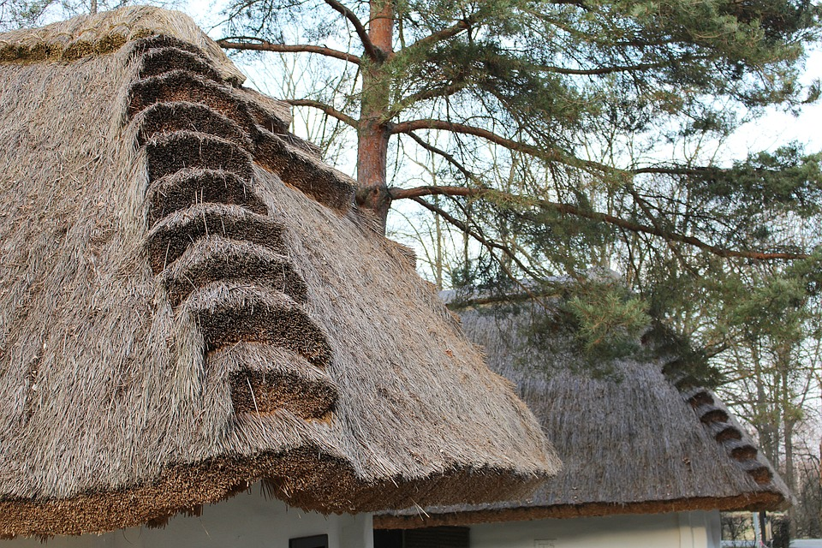
Key messages
Cluster management can make an important contribution to industrial modernisation in Lithuania
The next steps of industrial development require even better coordination and bundling of efforts
of companies in the same sector and across sectors
of companies and researchers
of companies with policy makers
Cluster management can enable that bundling and coordination
Identification of policies supporting cluster managers to be those coordinators

Slide 3
The European Observatory for Clusters and Industrial Change (EOCIC)
World-class clusters
SME access to clusters and internationalisation
Entrepreneurship in emerging industries
Industrial modernisation
Inter-regional collaboration + investments
Notes:
An initiative of the European Commission (DG GROW)
Single access point for statistical information, analysis and mapping of clusters and cluster policy in Europe
Target group: European, national, regional and local policy-makers, cluster managers and SME intermediaries
EOCIC goals are to:
Develop world‐class clusters with competitive industrial value chains that cut across sectors
Support industrial modernisation
Foster entrepreneurship in emerging industries
Improve SMEs' access to clusters and internationalisation activities
Enable more strategic inter‐regional collaboration and investments
The EOCIC will be merged with the European Cluster Collaboration Platform (ECCP) in 2020

Slide 4
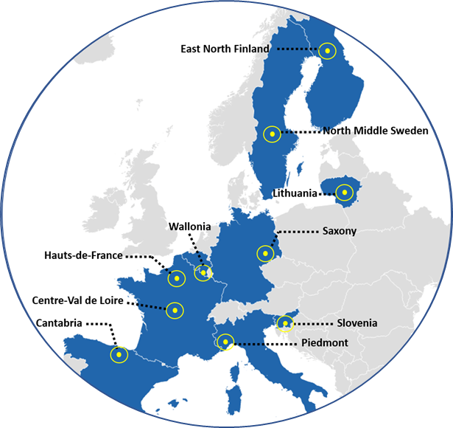
Services provided to the 10 pilot regions
Regional assessment report
Regional survey and benchmarking report
Regional policy review meeting and briefing
Joint peer review meeting
Summary report of lessons learned
Final workshop
Notes:
12 model demonstrator regions on modern cluster policy in support of industrial modernization
Regions in the middle of industrial modernisation process
SERVICES
Regional assessment report based on study visit, interviews and desk research of experts
Regional survey and benchmarking report
Policy review meeting and regional policy briefing
Presentation of results (e.g. at regional event)
Final joint peer review meeting in Brussels for all regions
Summary report of lessons learned

Slide 5
Megatrends – challenges and needs
Demographic trends
Productivity growth
need
Sustained economic growth
Integration in global value chains
Coordination and bundling
By cluster managers?
needs
need
Integration of business and research

Slide 6
Challenges for cluster organisations in Lithuania
Small scale of cluster organisations
Obtaining constant and long-term funding
Attracting members
(Intersectoral) collaboration
Internationalisation
Cluster management excellence
Notes:
Understanding of clusters rather as a set of activities and not as an organisation that groups enterprises and other stakeholders
Small scale of clusters
Guaranteeing constant and long-term funding and independence from government funding
Attracting members to a cluster organisation
(Intersectoral) co-operation to create joint products and move up the value chain
Internationalisation of clusters
Improving cluster management excellence

Slide 7
Strategic background to address these challenges
Build up strategic capabilities
New and more integrated networks
Create strong incentives for co-operation
Sustainable cluster organisations with effective management structures
Provide resources for cluster management excellence
Innovation Partnerships Competition
Create framework conditions for sustainable partnerships
Cross-sectoral innovation enlarging regional value chains
Use and expand existing networks to build trust
Objectives
Input
Results

Slide 8
The 4 steps in the Innovation Partnership Competition
Step 1
Step 2
Organisation of the competition
Selection/awarding
Step 3
Step 4
Set-up and funding
Results
Notes:
Criteria for/elements of the steps
Step 1: Organisation of the competition
Strategic relevance
Technological analysis
Market analysis
Stakeholder assessment
Conceptual design
Resource plan
Step 2: Selection/awarding
Innovation and development potential
Network performance
Implementation strategy
Future-oriented
Step 3: Set-up and funding
Coordination model development
Training for partnership management
Implementation of small pilot projects
Identification of policy needs
Step 4: Results
Move towards concrete achievements
Implementation of long-term projects
Increase own funding

Slide 9
Requirements for the applicant networks
Step 1:
Strategic relevance
Explain how the application supports the strategic focus
Step 4:
Assessment of stakeholders
Explain which stakeholders are needed to develop & foster the value chain
Step 2:
Technological analysis of suggested application and value chain
Provide overview of whether needed technologies exist and can be used
Step 5:
Conceptual design of collaboration building
Provide a concept on how collaboration should work (including training & expertise needs)
Step 3:
Market analysis of the suggested application and value chain
Prove understanding of the market where products would be produced and sold
Step 6:
Resource plan
Devise a plan outlining the resource use and expected revenues

Slide 10
Selection of Innovation Partnerships
Potential for development and innovation
Performance of the network
Selection of the Innovation Partnerships
Implementation
strategy
Future-orientation and sustainability
Notes:
Criteria for/elements of the steps
Step 1: Organisation of the competition
Strategic relevance
Technological analysis
Market analysis
Stakeholder assessment
Conceptual design
Resource plan
Step 2: Selection/awarding
Innovation and development potential
Network performance
Implementation strategy
Future-oriented
Step 3: Set-up and funding
Coordination model development
Training for partnership management
Implementation of small pilot projects
Identification of policy needs
Step 4: Results
Move towards concrete achievements
Implementation of long-term projects
Increase own funding

Slide 11
Questions?

Slide 12
Contacts and useful links
Contacts
General EOCIC information
Lucas Porsch
Associate Director
T: +32 483 73 67 86
e: l.porsch@vva.it
euclusterobservatory@eocic.eu
(also to subscribe to our newsletter)
https://www.clustercollaboration.eu/eu-initiatives/european-cluster-observatory
Frithjof Michaelsen
Senior Research Manager
T: +32 483 736 952
e: f.michaelsen@vva.it
#EOCIC
The EOCIC will be merged with the
European Cluster Collaboration Platform (ECCP) in 2020!
Keep following us on www.clustercollaboration.eu

