Slide 1
Networks, knowledge and opportunities for internationalization through clusters
Lucia Seel
ECCP Communication & Content Manager

Slide 2
The European Cluster Collaboration Platform
www.clustercollaboration.eu
A web platform – and much more!
The hub for cluster collaboration in Europe and beyond – for the benefit of your members … especially SMEs !
Showcased at WTO 2017!

Slide 3
The European Cluster Cooperation Platform

Slide 4
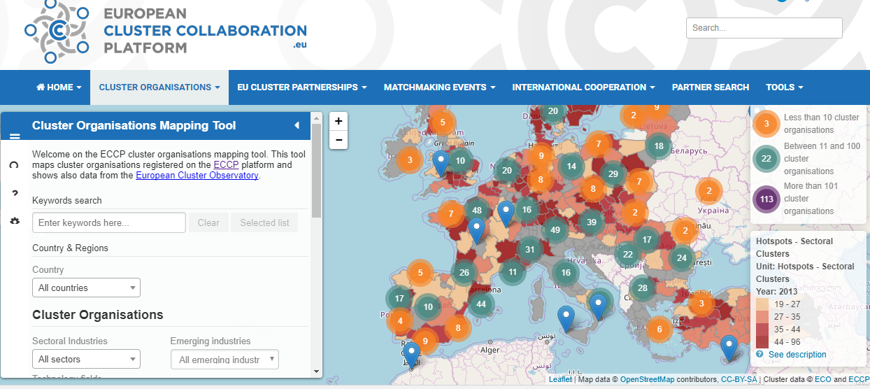
Cluster Organisations Mapping
Set up a profile on ECCP and put your cluster on the map!
Search by multiple criteria: sector, technology fields, country…
Currently 1088 clusters mapped (out of which 115 beyond Europe).
24 profiled Lithuanian clusters (plus 12 pending)

Slide 5
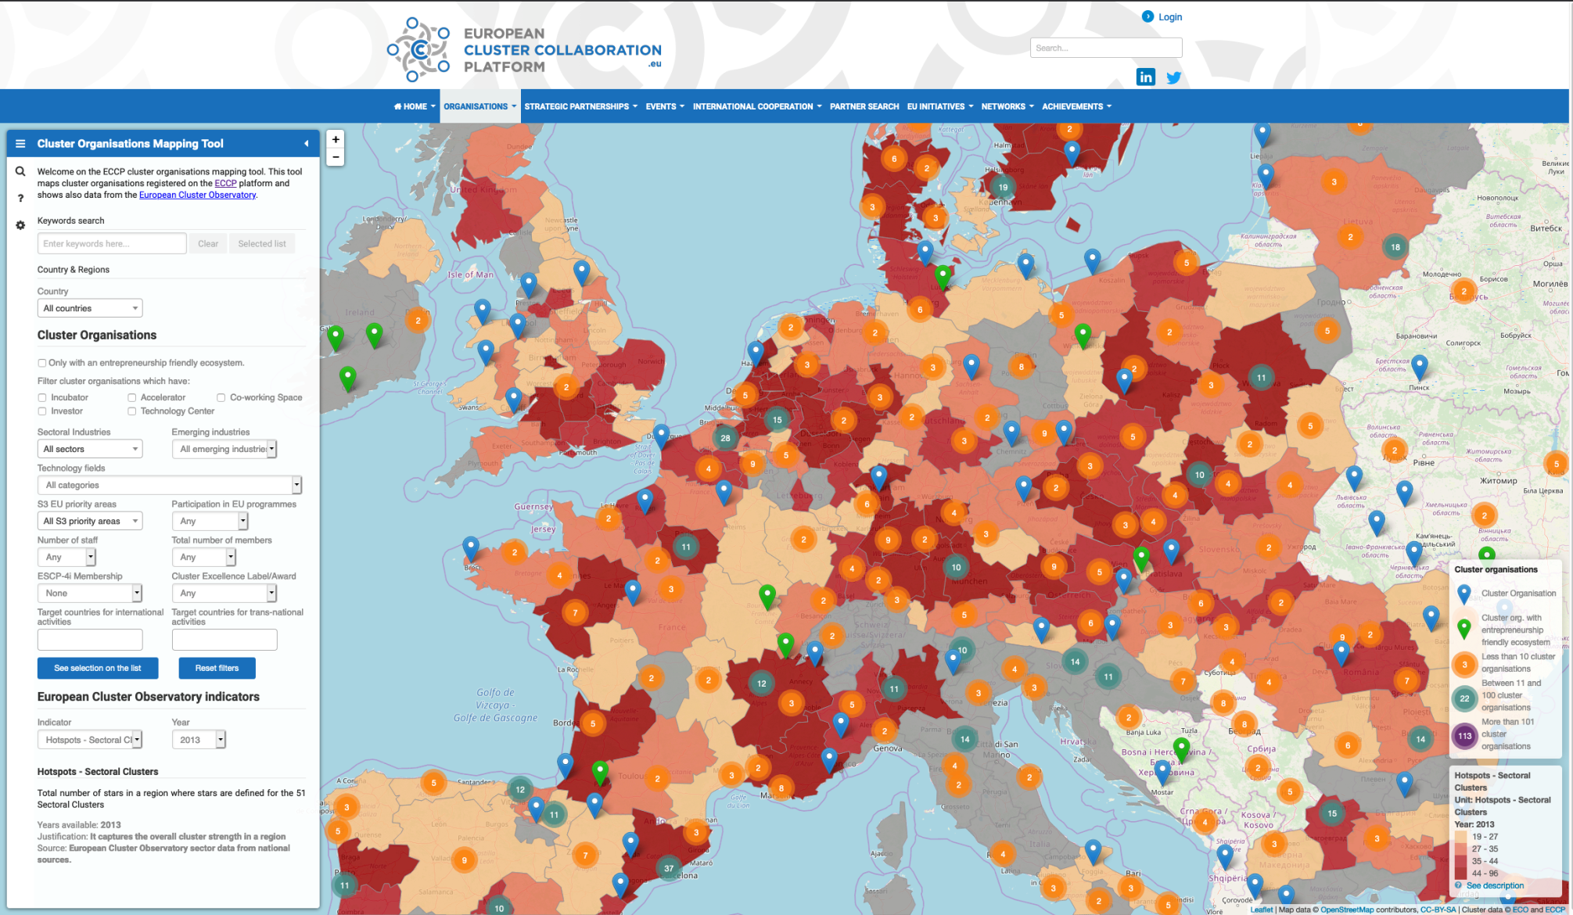
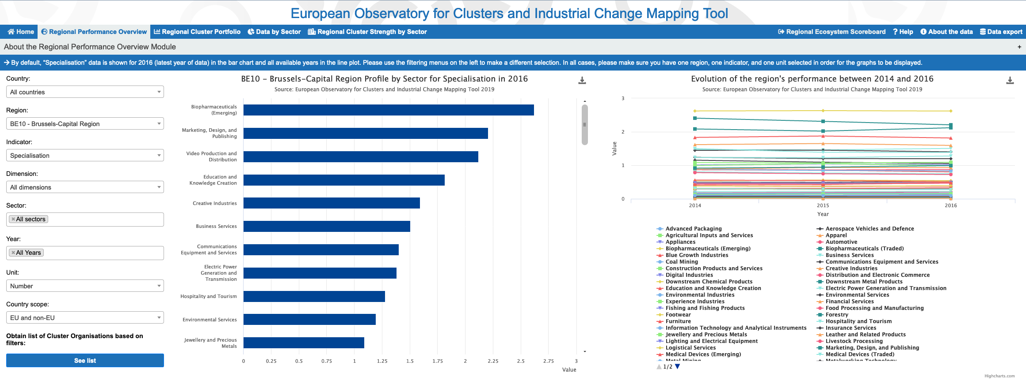
Unique Cluster Mapping
Key figures:
1088 cluster organisations
55 cluster associations
Unique EOCIC statistical analysis of all EU regions
3000+ news articles (65% by users)
16 matchmaking events with 3700 meetings
25.000+ average monthly visitors of the website
250+ calls published
Home of the 49 ESCP-4i and 9 ESCP-S3 partnerships
8 user surveys
Polls, webinars, testimonials

Slide 6
ECCP key achievements in 4 years:
More than 170 weekly digests/newsletters with more than 4000 subscribers
Almost 3000 news published (65% by users) and almost 1500 events promoted (56% by users)
More than 25000 average monthly visitors of the website.
More than 250 calls published and more than 80 partner searches published
16 ECCP matchmaking events with almost 3700 bilateral meetings and more than 50 formal agreements signed
More than 500 participants from Europe and 200 from countries beyond Europe attended the events
55 cluster associations/networks featured
58 profiled ESCP-4i (49) and ESCP-S3 partnerships (9)
79 cluster projects profiled (including INNOSUP and Cluster Excellence)
5 webinars and 7 user surveys
More than 420 references to the ECCP in external media

Slide 7
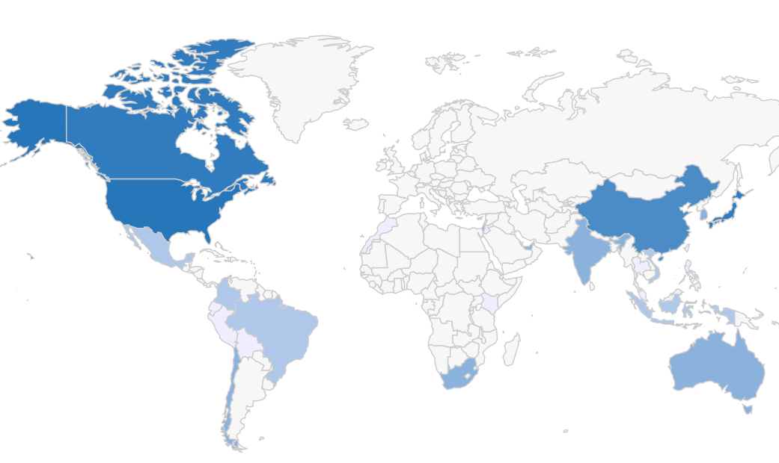
Internationalisation – Participation in the European Strategic Cluster Partnership for Going International (ESCP-4i) programme
Targeted countries by the clusters participating in the ESCP-4i programme:
https://www.clustercollaboration.eu/eu-cluster-partnerships/escp-4i/second-generation

Slide 8
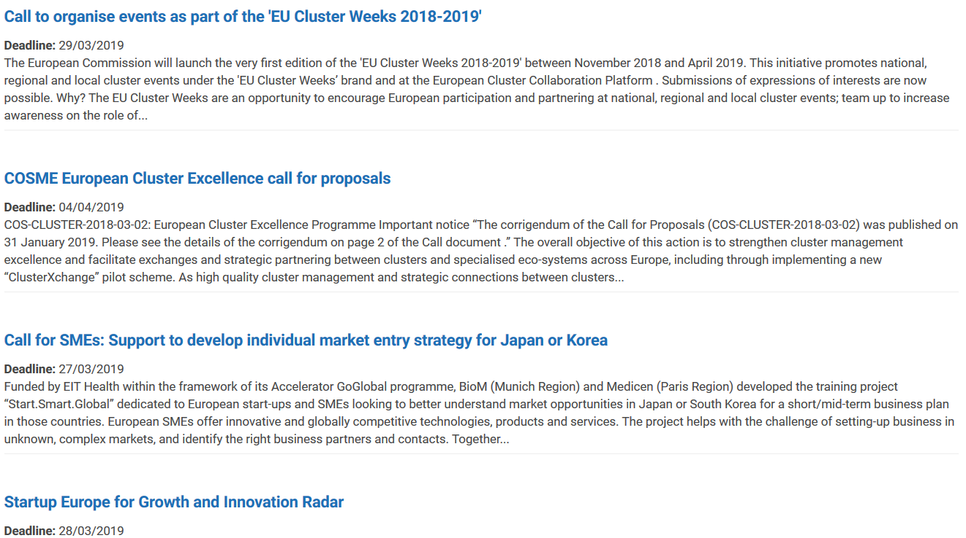
Inter-clustering and internationalisation - CONNECTIVITY
Find the opportunities, grasp them and find partners to go for them!
VISIBILITY & INTERACTION SUPPORT to the cluster community:
Cross-border and cross-sectors
Find cluster specific calls http://www.clustercollaboration.eu/open-calls
Find partners and be found as a partner http://www.clustercollaboration.eu/cluster-mapping

Slide 9
ECCP Tools – EU Cluster Initiatives, Networks & International Cooperation
Find out more about the existing European Cluster Initiatives (profiled cluster-related projects – COSME/INNOSUP but also from other EU programmes). Profile your other cluster projects (currently 79 published) and upload content for further dissemination
Search for Cluster Networks (territories & sectors) – the place giving visibility to the networks – currently 55 networks
Find out more on the cluster landscape in international countries (115 profiles of clusters beyond Europe), including analysis reports

Slide 10
ECCP – boosting your visibility and collaboration efforts
3 Steps to reach highest visibility in the international cluster community & stay well informed about international collaboration opportunities:
Set and regularly update your cluster organisation profile on ECCP. And upload content that is promoted in the global cluster community. It is important to make your cluster achievements visible
Subscribe to the ECCP newsletter and Weekly Digest – latest news from the cluster community every week - and surf on the web platform pages: news, events, open calls, existing networks and initiatives, partnership offers & demand
Set up your collaborative network: partner search tool, matchmaking events, pro-actively contacting potential partners, follow the open-calls, etc.

Slide 11
Attracting foreign investment through clusters and ECCP support
Clusters are ambassadors of their industrial sector AND of their region/country. This works best when the public authorities are strongly involved in the cluster‘s activities (example Google in Upper Austria). A strong and close cooperation with public bodies such as Regional Development Agencies or specialised agencies for foreign investment is key (e.g. Katowice Special Economic Zone – KSSE – ranked the best economic free zone in Europe in 2015/2016/2017/2018, acting as well as as coordinator of the Silesian Automotive and Advanced Manufacturing Cluster).
The other example is the collaboration between the Polish Investment and Trade Agency that introduces the Polish clusters to the potential investors in their presentations and development of dialogue (clusters are presented as strong assets).
Consider the correlation between talent attraction and foreign investment attraction.

Slide 12
Attracting foreign investment through clusters and ECCP support
Attracting foreign investment is correlated with a strong promotion of the regional/national assets => using the ECCP to promote the opportunities offered in the region/country by the cluster and by the regional/national cluster ecosystem (for example in the ECCP section dedicated to regional networks )
„Train“ clusters to include the promotional component dedicated to attracting foreign investment in their communication materials and in their direct communication with their international partners and counterparts.

Slide 13
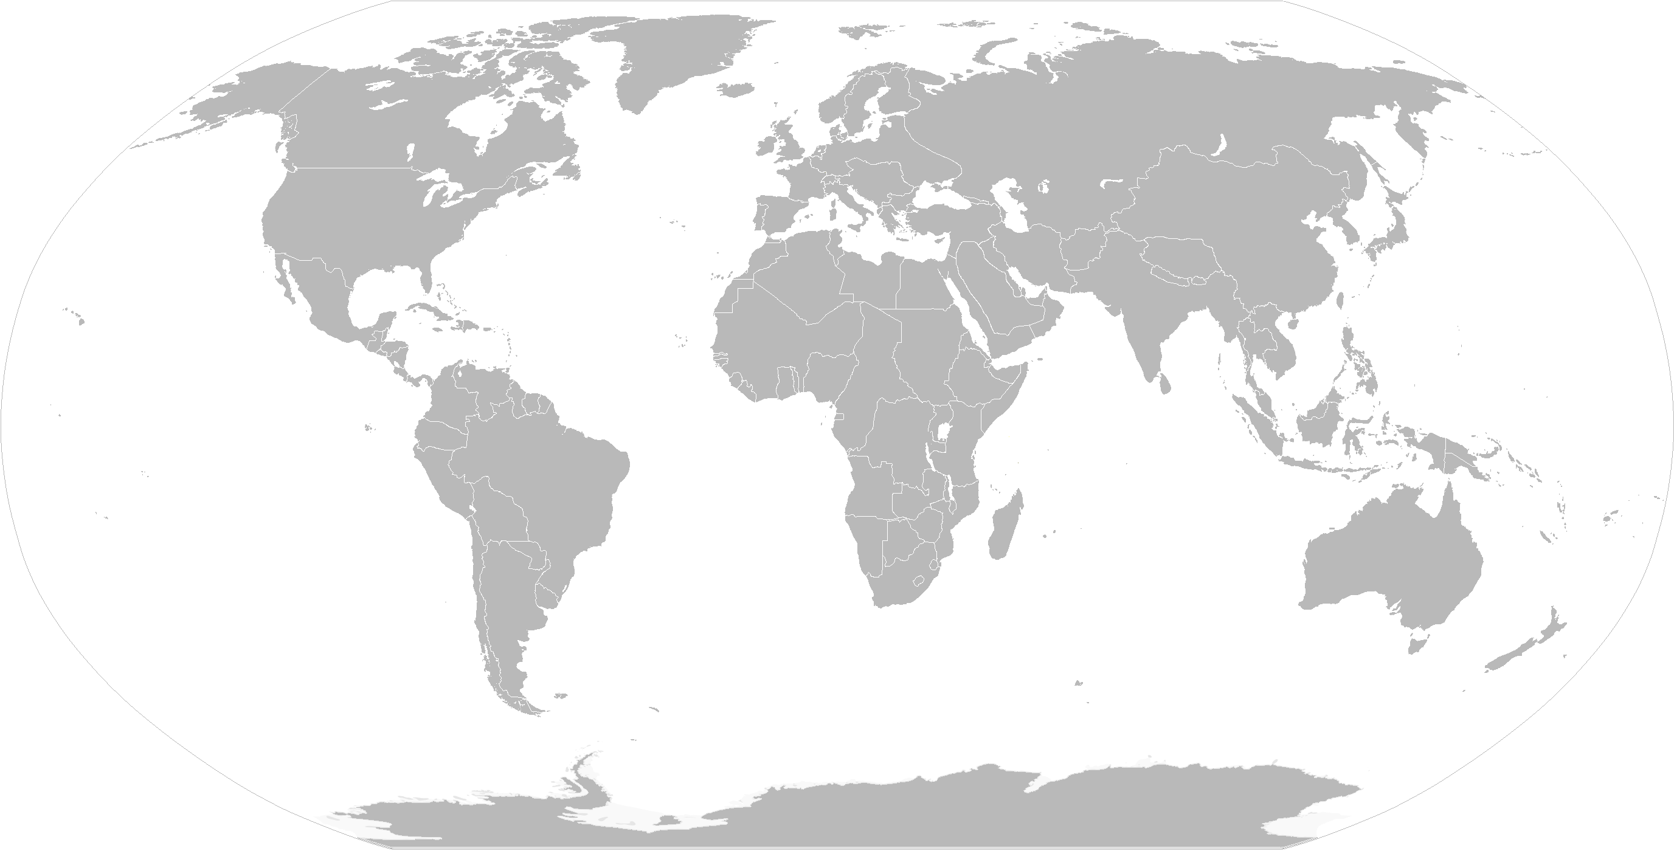
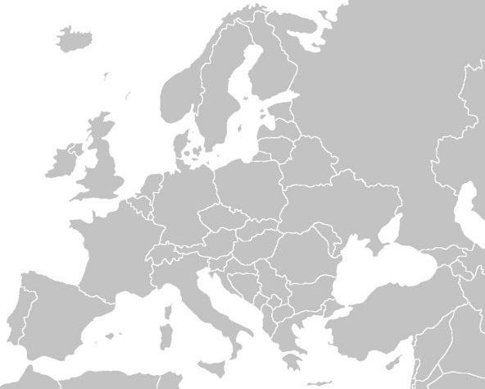
ECCP of the next generation: the 5 Cs
Clusters
Community
Capacity building
Connectivity
Collaboration
For all cluster stakeholders (organisations, policy makers, associations, initiatives, strategic partnerships, knowledge providers, support actors)

Slide 14
2020: A renovated European Cluster Collaboration Platform
EU Cluster Hub
Mapping
Supporting cluster actors
Supporting cluster policy
Connecting
Matchmaking
ClusterXchange
Forums of associations and partnerships
Statistical clusters
Actors
Visibility
Mapping policies and programmes
Capacity building
Capacity building
Technical assistance Cluster Go International

Slide 15
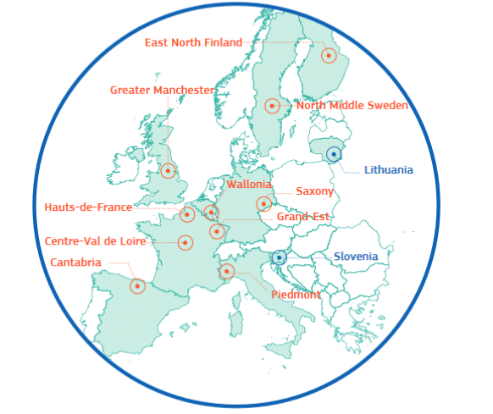
Cluster collaboration & intelligence tools
Comparing
regional strengths
(sectoral & cross-sectoral
cluster mapping)
Finding partners/cluster organisations
(partner search, matchmaking etc)
Regional Ecosystem Scoreboard
12 pilot regions in industrial transition
Trends, emerging industries, priority sector reports
Cluster policies in Member States
Smart guides including on cluster partnerships and entrepreneurship support
Mapping over 1000 cluster organisations
3689 bilateral meetings, 529 European participants
25000+ monthly visitors to the website
3700+ subscription to newsletters and 4000+ weekly digests
2800+ news items published
1300+ events promoted
http://www.clustercollaboration.eu
https://ec.europa.eu/growth/industry/policy/cluster/observatory

Slide 16
ECCP on social media & news service
Follow us on Twitter! Clusters_EU
And on LinkedIn: https://www.linkedin.com/company/european-cluster-collaboration-platform-eccp/
And stay informed through our weekly digest and newsletter!

Slide 17
Thank you for your attention!
Support needed?
contact@clustercollaboration.eu
Feedback is always welcome
Lucia Seel
ECCP Communication & Content Manager
lucia@luciaseel.eu
+43 660 5619056

