Slide 1


Krzysztof Krystowski
President of the Polish Clusters Association
Vilnius 10.12.2019

Slide 2
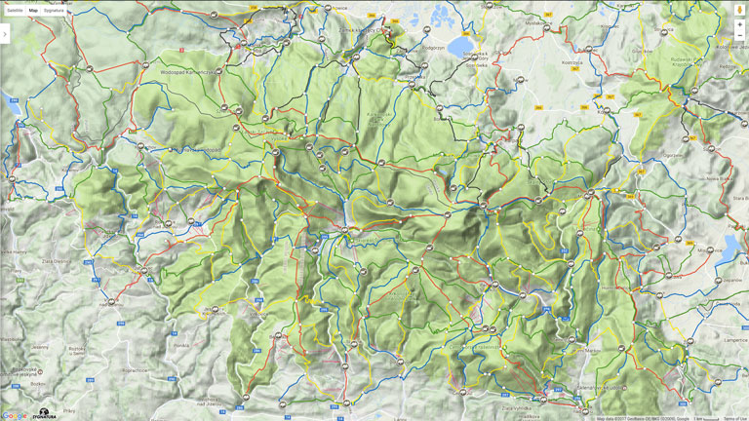





„Clusters increasing the productivity of the companies in the cluster, by driving innovation in the field, and by stimulating new businesses in the field."
Clusters are geographic concentrations of interconnected companies and institutions in a particular field.
Michael Porter

Slide 3
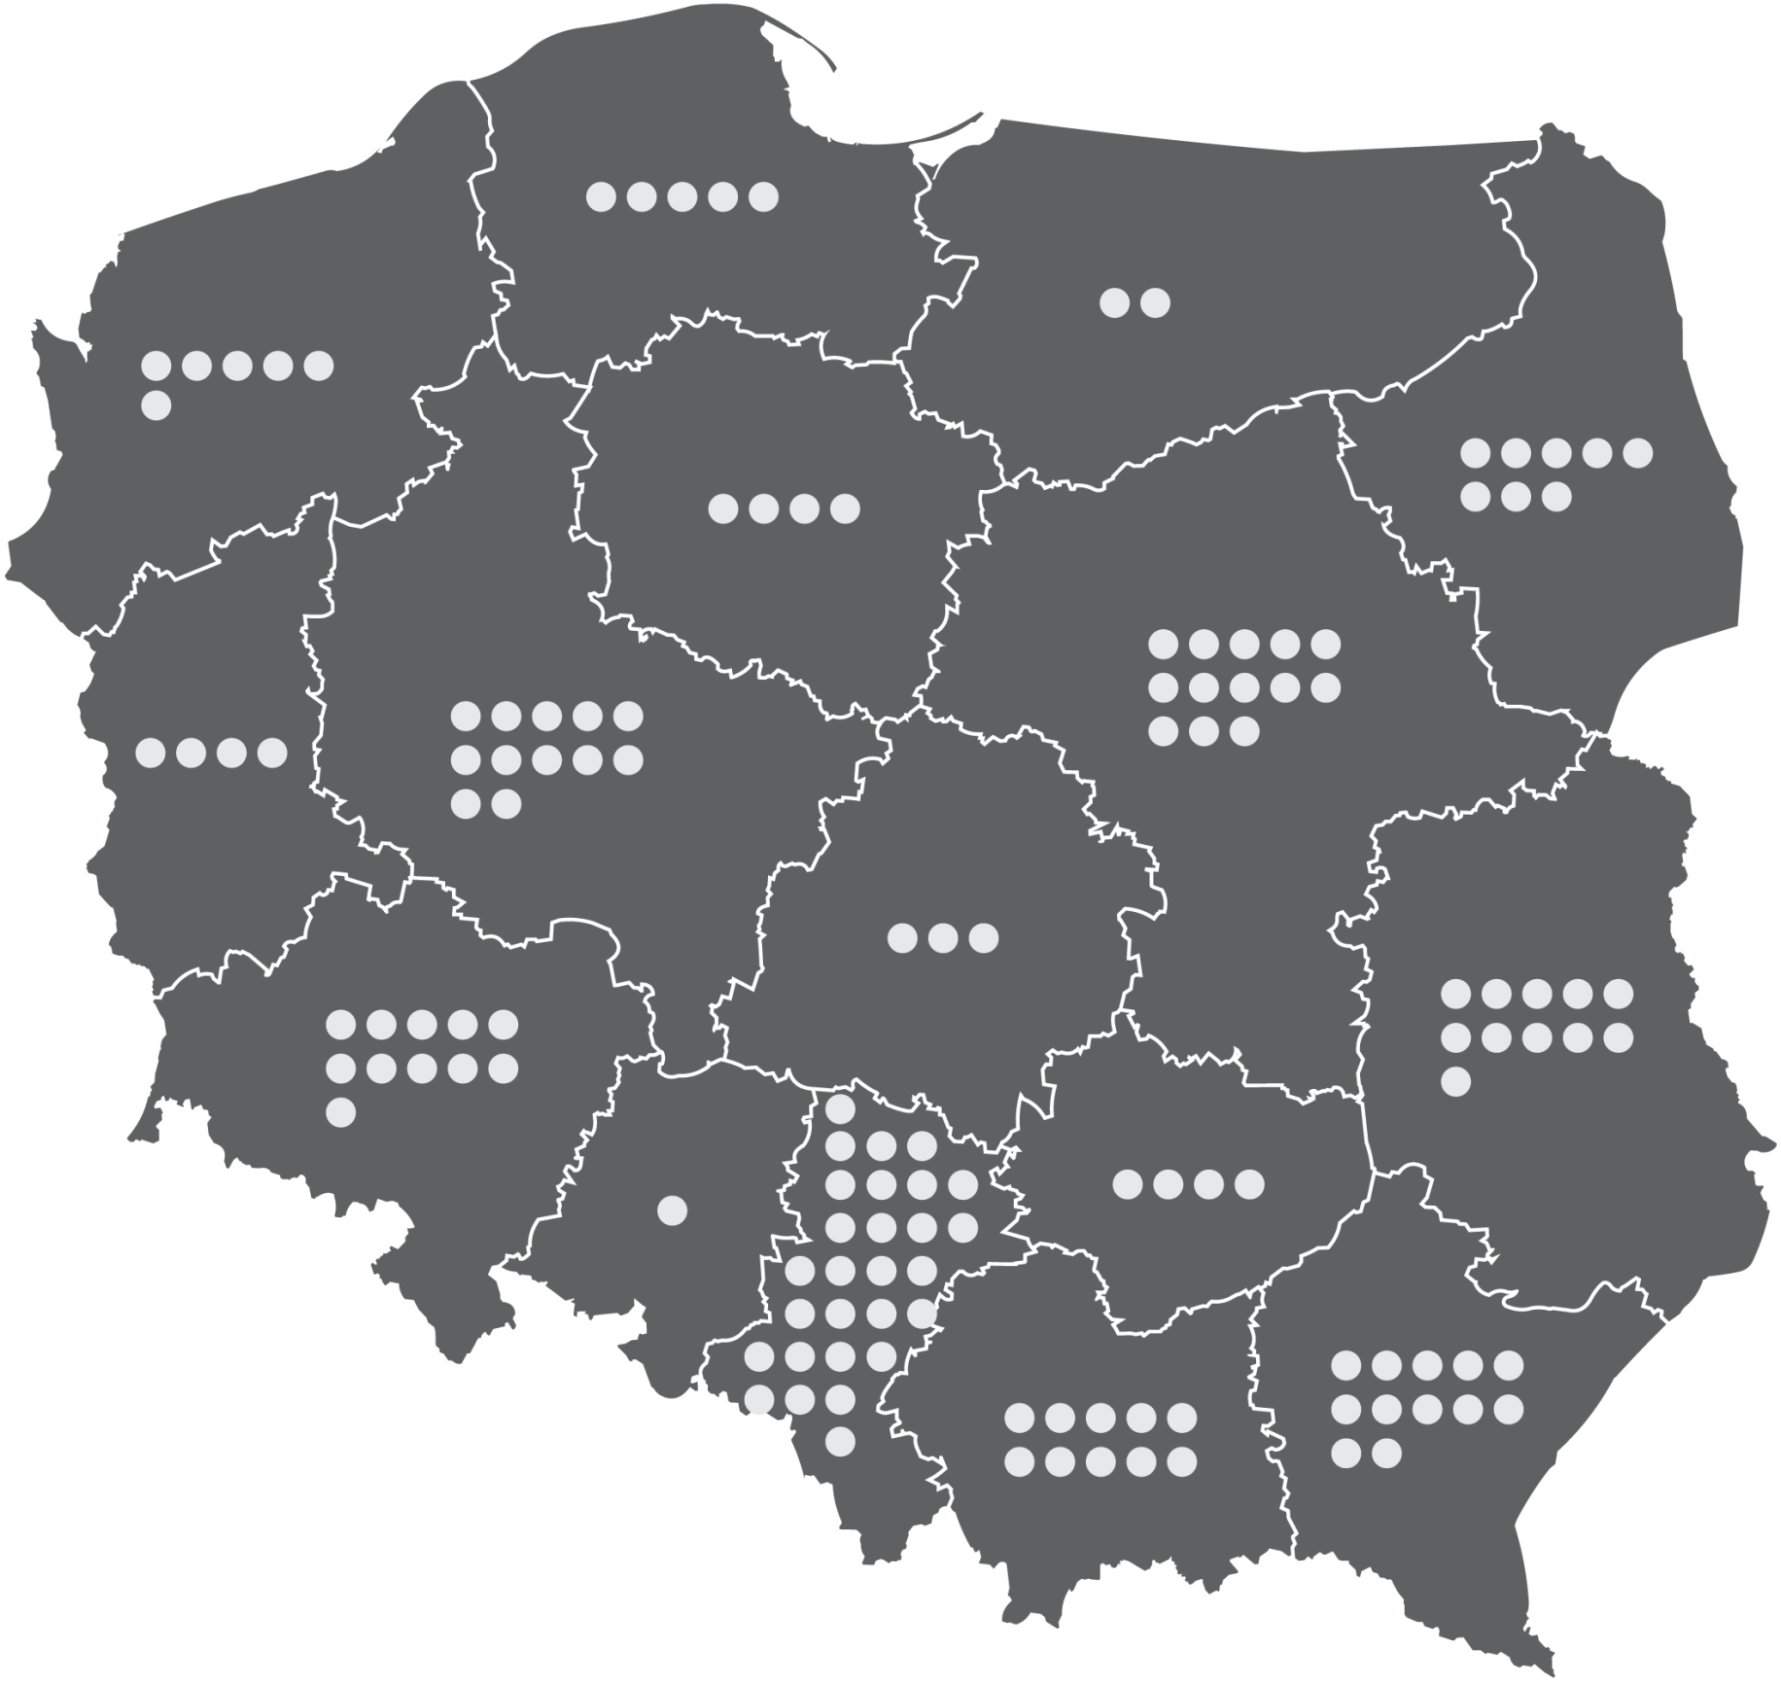
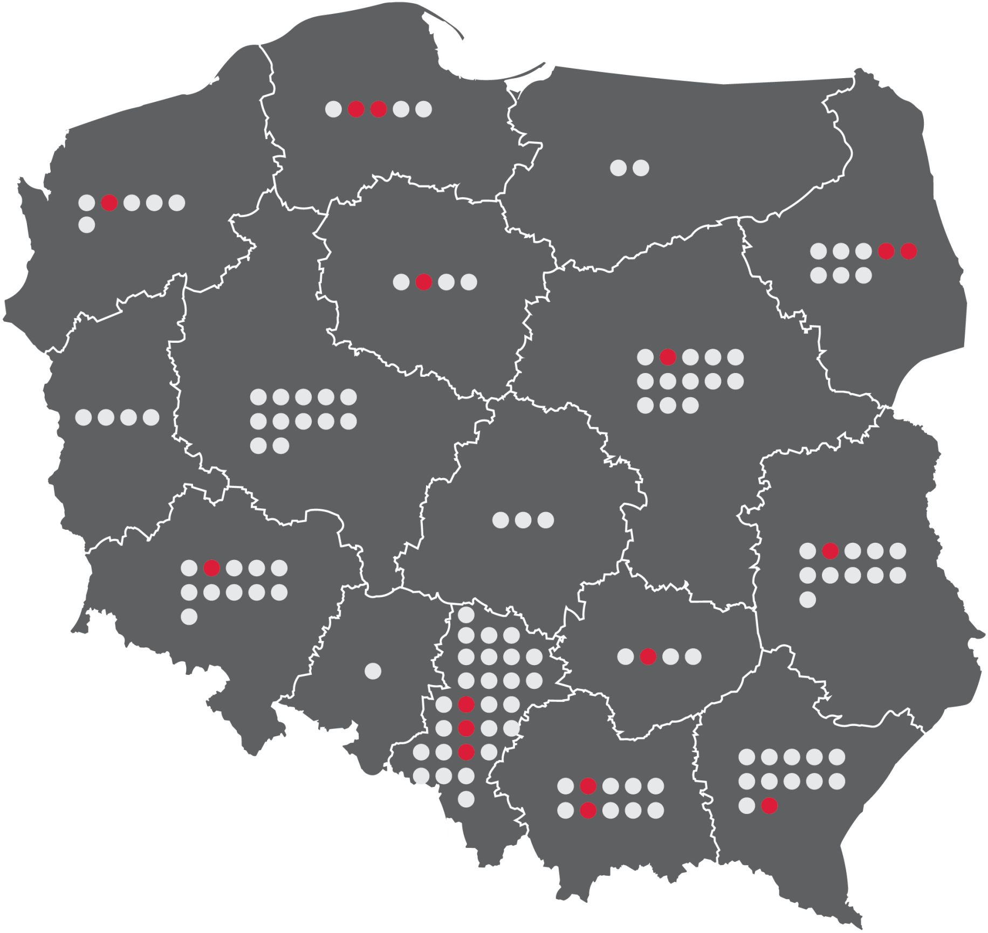

















GEOGRAPHICAL DISTRIBUTION OF CLUSTERS IN POLAND
clusters represent very different industries, from traditional to high-technological
- 28 specialties are distinguished
2003
First Polish cluster was established
>100
clusters in Poland
15
clusters with
Key National Cluster status
On the basis of the report from the study Report on the cluster inventory in Poland, 2016 edition, PARP, Warsaw 2016

Slide 4


KEY NATIONAL
CLUSTERS
Cluster of key importance for the national economy and high international competitiveness. National key clusters are identified at the national level, inter alia on the basis of criteria relating to: critical mass, development and innovation potential, existing and planned cooperation and the coordinator's experience and potential.
The Competition for the status of the National Key Cluster is organized by the Ministry of Entrepreneurship and Technology (previously by Ministry of Economic Development), which runs the Competition in cooperation with the Polish Agency for Enterprise Development.
List of Key Clusters National available on the website - http://www.pi.gov.pl/Klastry/chapter_95922.asp#Lista

Slide 5





Silesian Aviation Cluster
Interizon
Pomeranian ICT
Polish Aluminium Cluster
Silesia Automotive
Cluster
West Pomeranian Chemical Cluster „Green Chemistry„
Mazovia ICT Cluster
LifeScience Cluster Krakow
Aviation Valley
Bydoszcz Industrial Cluster
Waste Management and Recycling Cluster
Eastern Construction Cluster
Sustainable Infrastructure Cluster
Nort-South Logistics and Transportation Cluster
Polish Automotive Group Cluster
Metal Processing Cluster

Slide 6




Polish Clusters management excellence
In comparison with some UE members
 | PL | CZ | GER | ESP
Bronze label | 9 | 8 | 32 | 41
Silver label | 1 | 0 | 41 | 4
Gold label | 1 | 1 | 9 | 2

Slide 7
2007 - 2013
previous financial perspective
2014 - 2020
current support
Operational Programme Innovative Economye
Direct public support for clusters
In order to support the development of clusters, the OP IE has the greatest importance In under Priority 5 "Diffusion of innovation" of Measure 5.1 "Supporting cooperation links of supra-regional significance'. The objective of Measure 5.1 was to strengthen the position of competitive enterprises by supporting the development of linkages enterprises and between enterprises and research and development entities.
Tha budget > 50 mln EUR
In accordance with the adopted strategy within priority 5 of the OP IE, support was allocated to the development of supra-regional co-operation relations, in particular to
joint investment and advisory projects contributing to the easier transfer and diffusion of knowledge and innovation between cooperating entities.
Smart Growth Operational Programme 2014-2020
Cycle selection of National Key Clusters - Ministry of Economic Development
Internationalization of National Key Clusters - instrument dedicated to the instrument (EUR 33.25 million) - Polish Agency for Enterprise Development
Preferences for National Key Clusters projects (additional points for membership in the National Key Clusters, awarded e. g. by Polish Agency for Enterprise Development and Ministry of Economic Development Applicants during project evaluation)
Operational Programme Eastern Poland
Supporting supra-regional cooperation relations (EUR 100 million)

Slide 8
Internationalisation of Key National Clusters
Internationalization by acting on promotion and business activity linked with the research and development activities and innovative for cluster members"
Contract no. PIOR.02.03.03-24-0001/17-00
within the framework of Smart Growth Operational Programme 2014-2020
Financial support value: up to 80% for SMEs
but also
Up to 50% financial support for big companies

Slide 9
Representing interests of coordinators of clusters, cooperative relations and cluster initiatives on the national and international level
Supporting a harmonious development of the Polish economy basing on innovativeness and scientific research
Established
2012
Supporting the actions of consociated organizations in terms of executing their statutory tasks, especially – aiming at creating an innovative economy
> 40
Members
in association with 15 Key National Clusters
Establishing foreign contacts and cooperate with foreign partners
Supporting the development of clusters and the idea of clustering

Slide 10
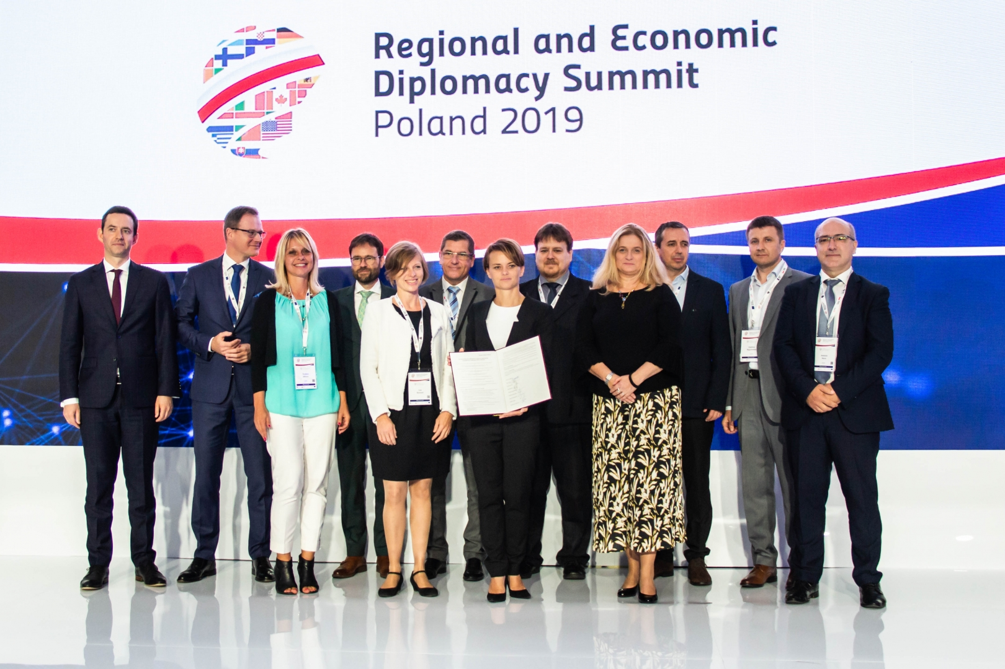
New European clusters organisation
European Cluster Alliance is an initiative of national cluster associations representing EU member-states to strengthen clusters position in the EU industrial and SME’s agenda
We would like to organize and be „one voice” of European Clusters
11 countries signed but we welcome members from all EU member-states
ECA in close cooperation with ECCP could be the „integration spot” for members of new Joint Cluster Initiatives

Slide 11

CONTACT
+48 884881891
poczta@klastrypolskie.pl
Księcia Bolesława 1/3
01-452 Warszawa

