Slide 1
Internal Market, Industry, Entrepreneurship and SMEs
Towards #post2020
EU Cluster Policy
How to use clusters to support European SMEs
Clusters Christmas Forum, Vilnius, 10 December 2019
Dr Anna Sobczak
Policy Officer for clusters
& emerging industries

Slide 2








EU cluster initatives
Building bridges across Europe's ecosystems
Clusters as accelerators for innovation & industrial change
Capacity-building
Inter-regional & international cluster cooperation
Cluster Excellence Programme

Slide 3

Cluster policies at centre of regional, national & international industrial policies
- 31 national cluster programmes in 20 European countries with different extent of support
- High importance for regions with 2.320 billion € of envisaged ESIF investments (2014-2020)
Many non-European countries use clusters to promote growth, e.g. Canada's industrial supercluster
=> crucial instrument for economic development
https://events.idloom.com/files/events/4538/files/eocic-cluster-programme-report-2905.pdf
Notes:
- 31 national cluster programmes in 20 European countries with different scales (up to 144 million € annual budget in France)
- "Cluster support and business network support" of high importance for regions with 2.320 billion € of envisaged ESIF funding (2014-2020) according to the ESIF viewer tool
- Many non-European countries too use clusters to promote growth, e.g. with Canada supporting industrial supercluster and China super region clusters
=> crucial instrument for economic development

Slide 4
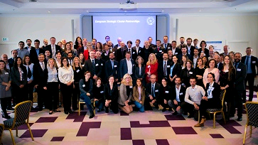
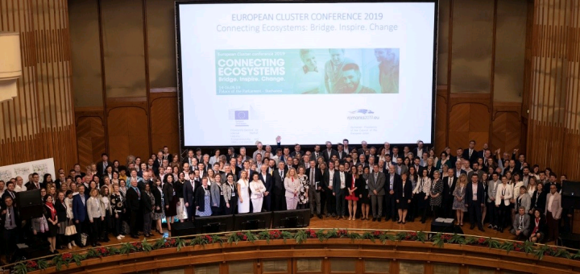
Examples of stakeholder views
Council Conclusions on Industrial Policy of 12 March 2018 called for the further development of the European cluster policy to support the emergence of new value chains across Europe;
Vienna Declaration (Friends of Industry) of 14 Industry Ministers of 4 October 2019 called for an ambitious cluster policy as one of its key action items to foster strategic European value chains proposed for the future EU Industrial Policy to spread benefits of digitalisation with emphasis on enhanced collaboration and inclusion of SMEs.
Participants at Partnering event of 50 European Cluster Partnerships on 29 October 2018 called for both large-scale and networking projects and emphasised the need to co-designing cluster services for SMEs, identifying the right counterparts, training and interregional mobility.
Participants at the European Cluster Conference of May 2019 with 450 participants discussed how to better connect Europe's ecosystems, with input on digitalisation and skills gap, Circular Europe and Shared value and social impact.

Slide 5

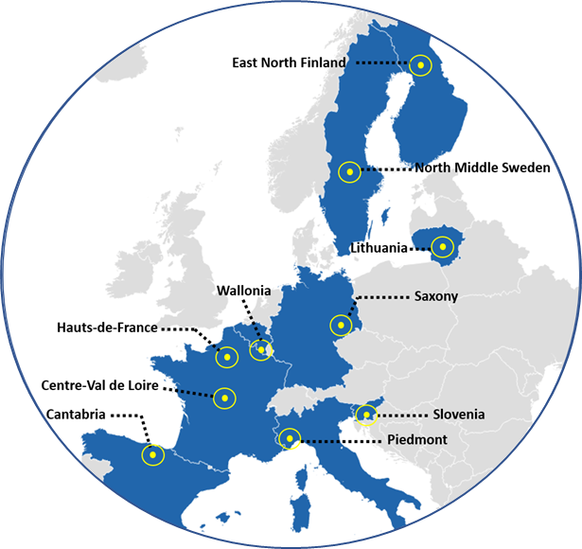
policy advice
Supporting modern cluster policy in 10 pilot regions in industrial transition
Helping regions undergoing industrial transition to develop new approaches to restoring their growth & productivity
➔ clusters as a key driver for smart specialisation
➔ modern cluster policy can help shape regional industrial transition.
Source: http://ec.europa.eu/regional_policy/sources/docgener/informat/industrial_transition/pilot_industrial_transition.pdf

Slide 6







Joint regional challenges in the pilot regions in industrial transition
Many of the challenges addressed in the Policy Briefing Reports are common to several pilot regions, although the responses to these challenges are tailored to the region’s profile
Lack of access, opportunities and awareness of research & innovation infrastructure hampers SME participation
Insufficient collaboration and cooperation between different actors in the regional ecosystem
Need to improve productivity by moving to higher added value networks and value chains
Need to increase cluster management capabilities and capacities
Need to reinvigorate the entrepreneurial dynamic (e.g. financing, entrepreneurial discovery, internationalisation, skills gaps)
JOINT CHALLENGES
East & North Finland
North Middle Sweden
Hauts-de-France
Wallonia
Centre-Val de Loire
East & North Finland
North Middle Sweden
Lithuania
Piemonte
Cantabria
Wallonia
Saxony
East & North Finland
Slovenia
Lithuania
Cantabria
Slovenia
Lithuania
North Middle Sweden
Piemonte
East & North Finland
North Middle Sweden
Piemonte
Wallonia
Centre-Val de Loire
WHERE?

Slide 7
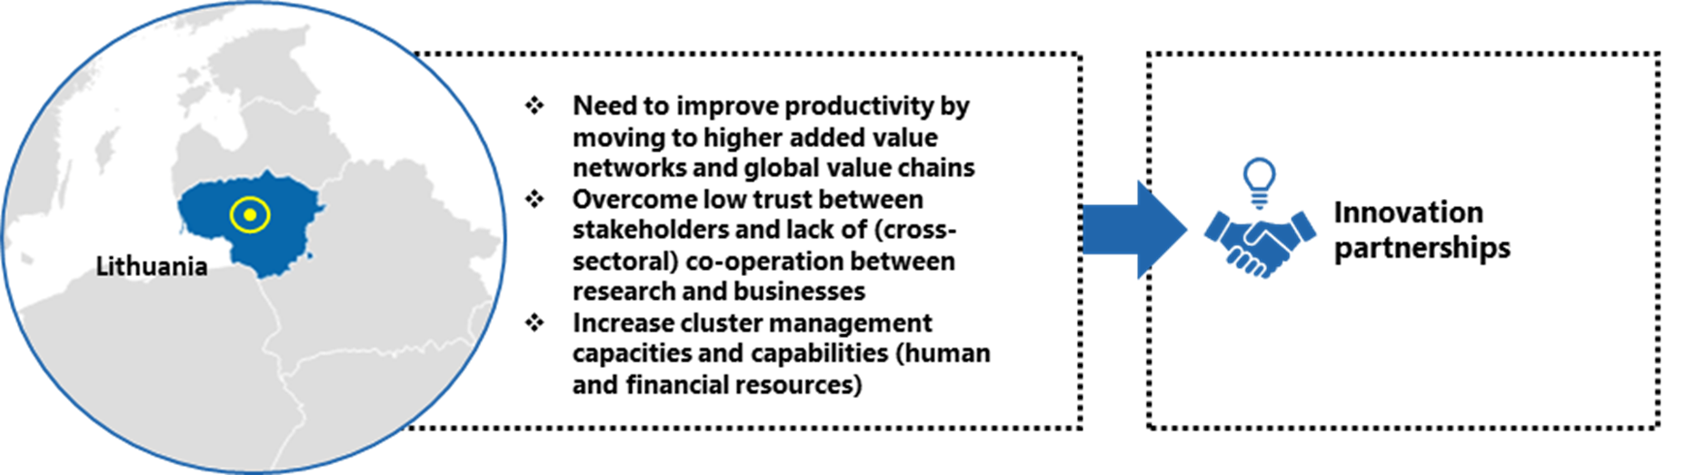
Regional Challenges & recommended measures: Lithuania
https://www.clustercollaboration.eu/news/policy-briefings-10-european-regions

Slide 8
New EU Commission – new priorities
… EU Green Deal - first 100 days
… EU Industrial Strategy – March 2020
… EU SME Strategy

Slide 9
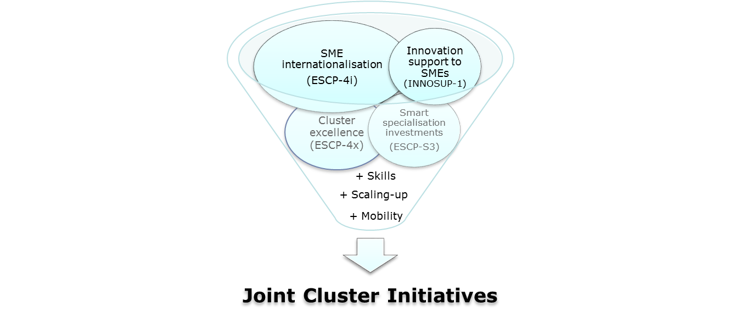






  Shaping European strategic value chains
  through connecting specialised ecosystems
  Boosting internationalisation
  & access to global value chains
  Facilitating industrial transformation towards:
  +uptake of advanced technologies & services, digitalisation,
  +Upskilling & talent attraction & entrepreneurship acceleration
  +new business models,
  +resource-efficient solutions towards decarbonisation & Circular Economy,
  +creativity & design
#post2020 – COSME part of SMP

Slide 10
Joint Cluster Initiatives
Industry-focused actions guided by joint strategies of clusters + other associated specialised SME support actors
Thematically targeted for 10-20 industrial specialisations, with cross-regional + cross-sectoral outreach to SMEs
Creating business opportunities + accelerating growth by channelling direct scaling-up support to groups of SMEs for:
  Shaping European strategic value chains
  Boosting internationalisation
  Facilitating industrial transformation
Specific recital (28) on clusters in Regulation

Slide 11
Specificities of the Joint Cluster Initiatives
Achieving critical mass
Building transnational transformation partnerships upon success of existing EU cluster initiatives under COSME and Horizon2020
Sustainable partnering with continuation funding (if performance and participation milestones are reached)
Supported by the European Cluster Collaboration Platform
Contributing and building linkages to other EU actions: (digital) innovation hubs and investments under Cohesion Policy and Horizon Europe & exploring synergies with Erasmus+

Slide 12

Cluster facilitated projects
for new industrial value chains
INNOSUP-1
(Video)
Notes:
12

Slide 13

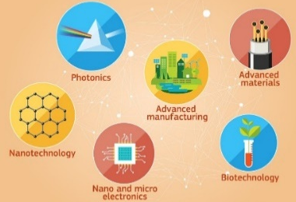
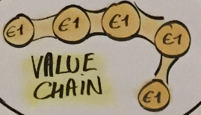

key focus
€5 mln per project
SMEs (75 % of the budget)
Using clusters to support innovation in SMEs beyond the consortium
Linking with smart specialisation (regional innovation) strategies
Cross regional + cross-sectoral cooperation
new or significantly improved products/services
Set of support innovation tools

Slide 14
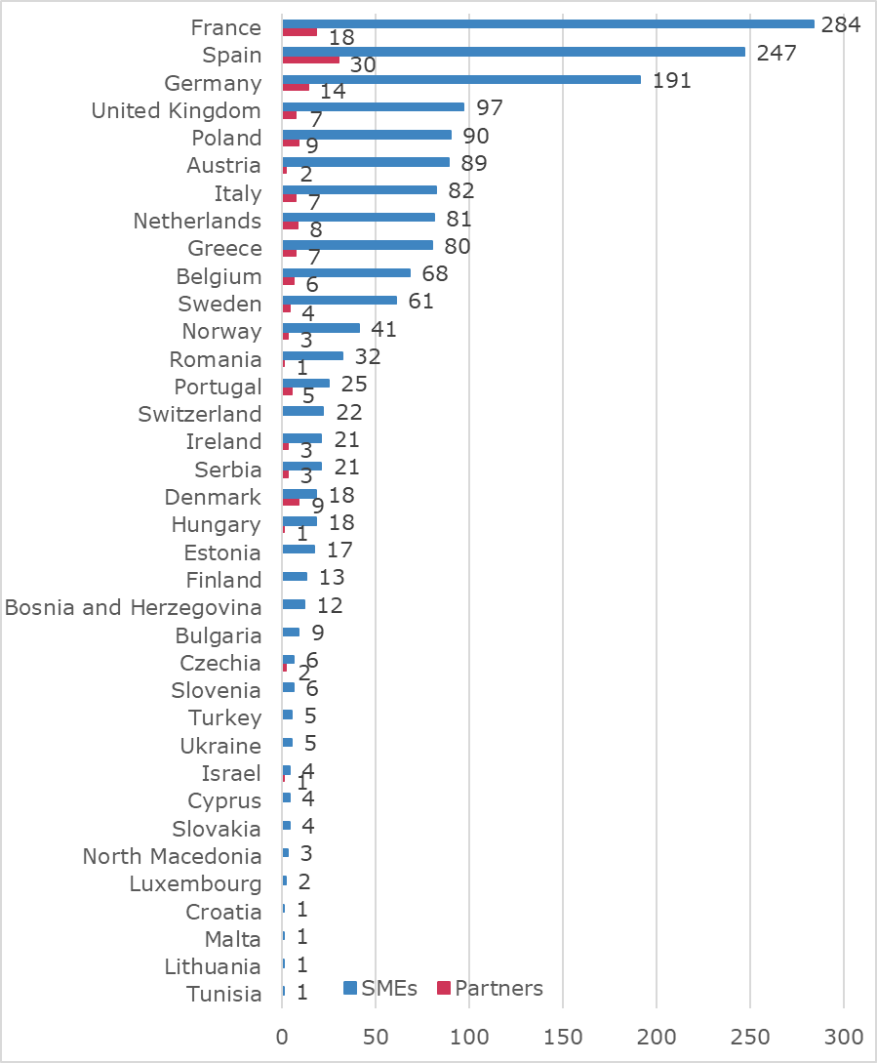
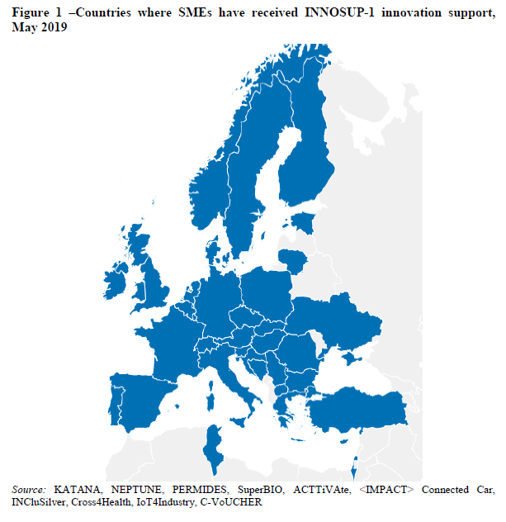
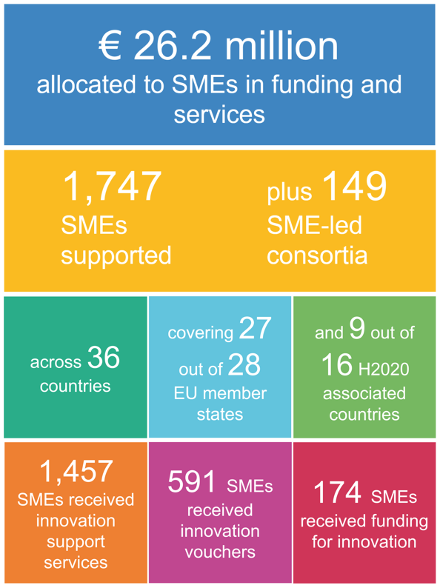
during 2015-2020, INNOSUP-1 aims to support
2,000 SMEs directly (€ 130 million)

Slide 15
Notes:
ICT (10), Agrifood (7), Health (6), Advanced Manufacturing/process techn. (4), Bio (4), Aerospace (3), Blue growth/Water (3) amongst the most popular cross-sectoral focus themes.
Corresponds to the top smart specialisation priorities selected by regions
1. Health & life sciences
2. Digital growth
3. Energy
4. Industrial modernisation
5. Agrifood

Slide 16











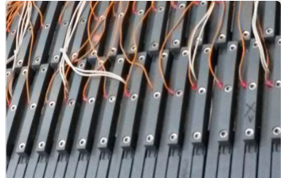


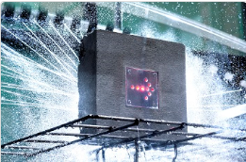


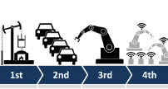



21 thematic areas under S3 for Industrial Modernisation
http://s3platform.jrc.ec.europa.eu/thematic-areas
Advanced manufacturing
Non-food biomass
Sport
Nano-Enabled Products
Hydrogen Valleys
Digitalisation & Safety for Tourism
3D Printing
European Cyber Valleys
Artificial intelligence & Human machine
Chemicals
Advanced materials on bateries
Personalised medicine
Social
Economy
Mining
Industry
SMEs to Industry 4.0
Textile
Innovation
Water
Smart Technologies
Medical
Technology
Efficient & Sustainable Manufacturing
Photonics
Safe & sustainable mobility

Slide 17
Lessons learnt so far
+ Delivering on reaching out to SMES
+ Highest impact when majority of project partners are cluster organisations
+ Serving the needs of SMEs with customized support for specific challenges
+ Impact lies in the combination of support tools
+ More scope for scaling up linked to financing and internationalization

Slide 18



















https://www.clustercollaboration.eu/eu-initiative/innosup-calls
http://katanaproject.eu
http://www.neptune-project.eu
http://www.h2020-superbio.eu
http://permides.eu/
http://acttivate.eu
https://www.innolabs.io
http://www.impact-accelerator.com/connected-car/
http://www.inclusilver.eu
http://www.cross4health.eu/
https://www.projectdiva.eu/
https://www.iot4industry.eu/
http://vidaproject.eu/
https://c-voucher.fundingbox.com/
http://s3food.eu/
https://www.smartx-europe.eu/
https://www.digibcube.com/
https://parsec-accelerator.eu/
https://blockis.eu/
18 funded projects

Slide 19
Next call for Innosup-1 proposals
Call opens 07/11/2019
EUR 25.15 Mio (EUR 4 to 5 Mio per project)
Deadline (1nd stage): 2nd April 2020
Deadline (2nd stage): 8 September 2020
Number of projects to be funded: 5-6
https://ec.europa.eu/info/funding-tenders/opportunities/portal/screen/opportunities/topic-details/innosup-01-2018-2020
ECCP https://www.clustercollaboration.eu/eu- initiative/innosup-calls
Horizon 2020 Innosup data hub https://innosup.easme-web.eu/

Slide 20
Each proposal should demonstrate the capacity to:
validate ideas for structured innovation projects driven by SMEs from different sectors & regions/countries in collaboration with other innovation actors
facilitate the coordination towards new industrial value chains through this collaboration space
support innovation activities
channel a mix of different targeted entrepreneurial & innovation support measures
Mentoring + coaching + innovation + technical assistance vouchers directly to SMEs
further support their development, integration & large-scale demonstration in a strategic manner.

Slide 21



  Cluster Internationalisation Programme for SMEs (COSME, €19M)
Supporting SME access to global value chains through clusters
  European Cluster Collaboration Platform
  International cluster matchmaking events in third countries and Europe
  European Strategic Cluster Partnerships - Going International (ESCP-4i)
    "Clusters Go International" action

Slide 22
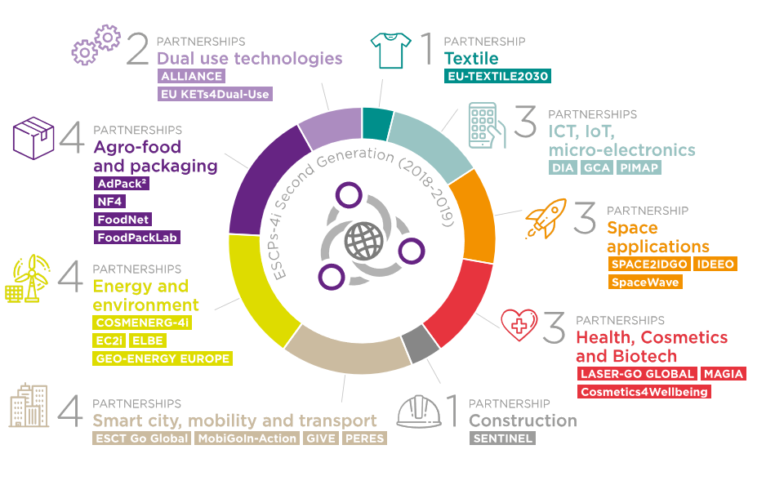





European Strategic Cluster Partnerships for Going International (ESCP-4i)
Partnership formed by European clusters
they develop + implement joint internationalisation strategies, for the benefit of SMEs
25 Cluster Partnerships in 2018-2019 (€ 7.24 mln)
141 cluster orgs representing > 17,000 SMEs
Main target countries:
New Call open till 30 October (€8.3 mln)
24 partnerships planned in 2020-2021

Slide 23
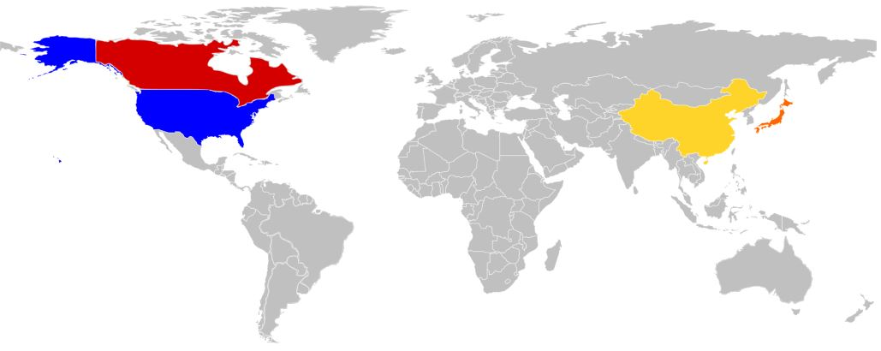

Third countries targeted by the 25 EU 'Clusters Go International' Partnerships (2018-2019)
Canada: 9
USA: 11
China: 8
Japan: 7
4 partnerships
Singapore
South Africa
Israel
India
South Korea
UAE
2 partnerships
Taiwan
Indonesia
Egypt
Colombia
Viet Nam
Jordan
3 partnerships
Australia
Chile
Mexico
Morocco

Slide 24
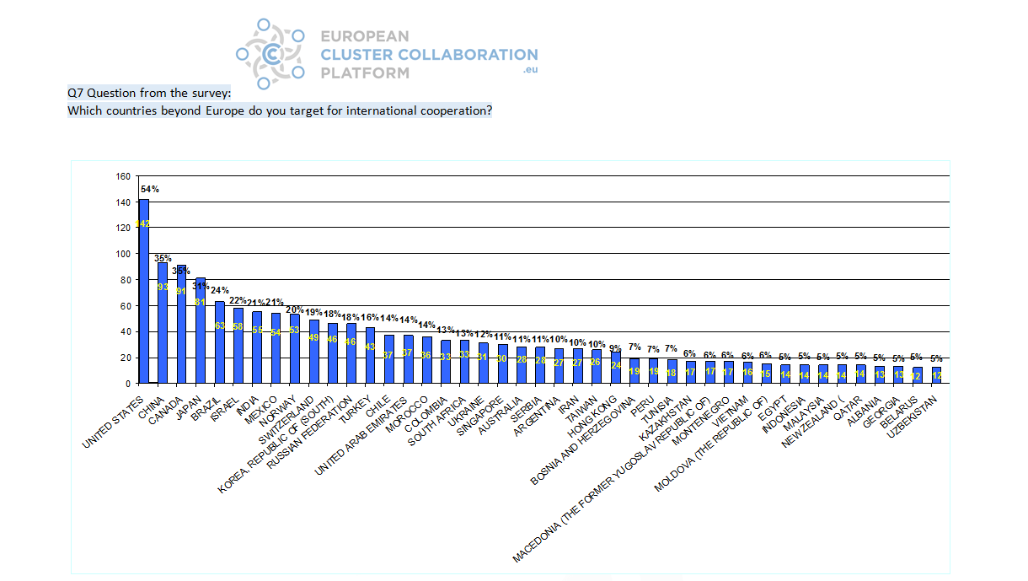
Priority Target Markets by European clusters
87% of European clusters interested to support internationalisation of their SMEs in third markets,
only 34% actually doing it*.
* Data based on a survey of 300 clusters across Europe conducted in June 2017

Slide 25
Outcomes
    Findings from EOCIC report –
    - Quantitative responses to question on results achieved by ESCP-4i SME members due to their involvement in ESCP-4i activities

Slide 26
Cluster matchmaking events 2020
Interested?
Watch out for our calls of expression of interest @Clusters_EU
Japan – 1-3 April, Strasbourg, France
Korea – April-May, Advanced Manufacturing (in EU)
Taiwan (in Taiwan)
Canada – 2nd semester, poss. Blue growth (in EU)
South MED – poss. October (in EU)
With other European clusters – 11 Nov, Berlin, Germany, European Cluster Conference

Slide 27
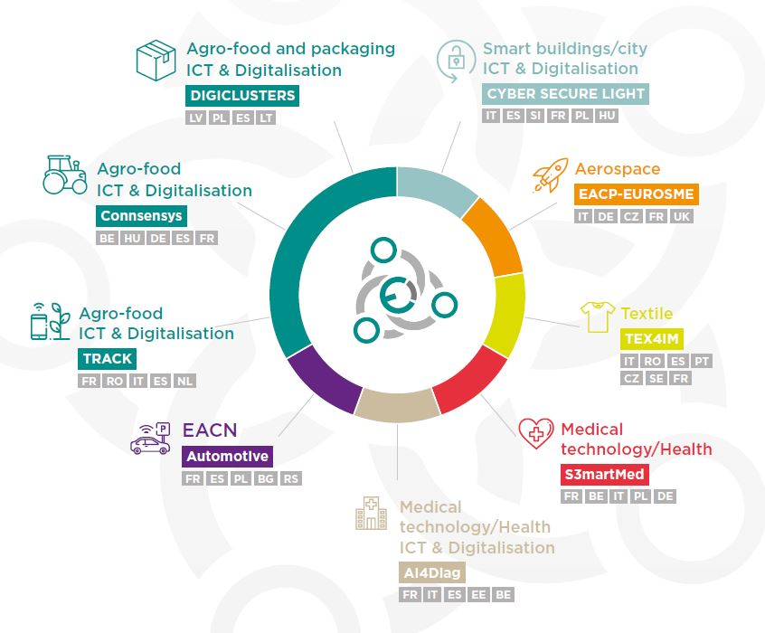
European Strategic Cluster Partnerships for smart specialisation investments
◆ 9 cluster partnerships to boost cooperation & investments linked to smart specialisation & industrial modernisation
◆ €3.1 million (COSME) with 346.000 €/project
◆ 57 project partners from 19 European countries
◆ more than 4.500 SMEs directly or indirectly
benefited
◆ complement mobilisation of interregional
S3 partnerships
under Smart Specialisation Platform
for Industrial Modernisation
◆ promoting joint innovation investments along
S3 priority area related to
industrial modernisation

Slide 28

European Cluster Excellence Programme
Strenghten cluster management excellence & strategic interregional partnering to foster cluster capacity building & SME competitiveness
11 completed projects (€2.47mln) 57 cluster org. representing 11,000 SMEs
10-12 new cluster partnerships (ESCP-4x) to start around Feb.2020 (€3.6mln)
Enhance cluster managers‘ skills (benchmarking + training + coaching +mentoring)
Support cluster strategy development (at cluster + partnership levels)
Organise twinning+collaboration+ networking/learning activities +joint cooperation projects
Implement a new „ClusterXchange" pilot scheme

Slide 29


The ClusterXchange pilot scheme
Short-term exchanges to foster strategic interregional collaboration to explore new growth opportunities & industrial transformation:
Identifying new partners
enhancing market access
Supporting networking
On-the-job training
Sharing experiences
Capacity-building activities
How is it implemented?
- Matching IT tool/support
- Implemented by cluster organisations of Cluster Partnerships (ESCP-4x)
- Small financial support to visiting organisations (lump sums of max. 1100 EUR)
Objective:
Overall 500 exchanges
50% involving SMEs
25% other participants beyond direct beneficiaries
Who can benefit?
Cluster organisations
SMEs
Scaling-up support organisations
starting later in 2020

Slide 30
To participate in the ClusterXchange
Opens in 2nd quarter 2020
Register at European Cluster Collaboration Platform (www.clustercollaboration.eu)

Slide 31
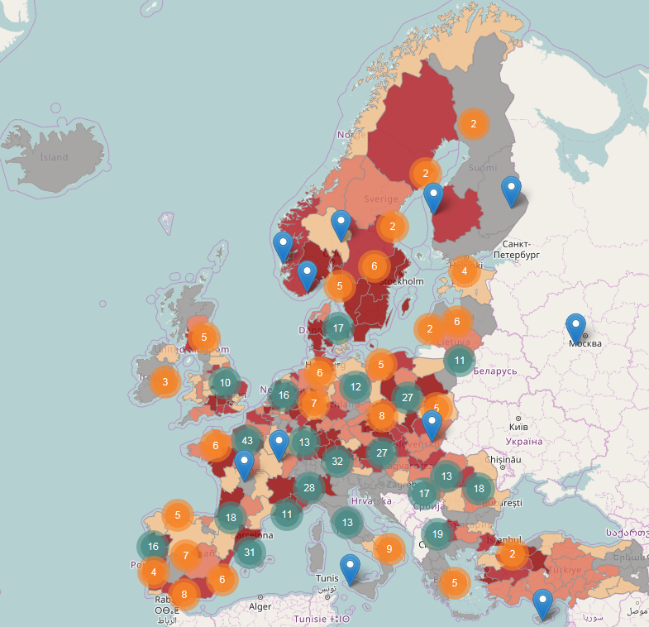

European Cluster Collaboration Platform
connecting over 1.000 cluster organisations
Boosting collaboration and connecting enterprises by using clusters as multipliers
Reaching out to:
over 100.000 SMEs
8.000 large firms
11.000 universities/research organisations.
http://www.clustercollaboration.eu/

Slide 32

European cluster initiatives explained (video)

Slide 33

Smart Guide to Cluster Policy
A couple of concepts,
Eight Do’s and Don’ts, and
Plenty good practice examples …
of how to make better use of clusters for promoting regional industrial modernisation, supporting the growth of SMEs and encouraging smart specialisation.
Available at http://publications.europa.eu/en/publication-detail/-/publication/e1fb9f84-2ba9-11e6-b616-01aa75ed71a1 /

Slide 34
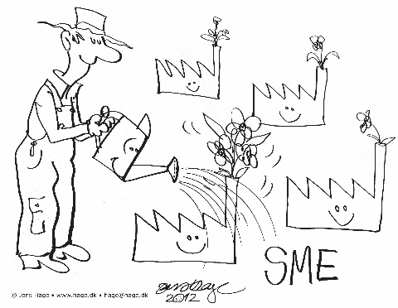
Thank you
https://ec.europa.eu/growth/industry/policy/cluster
http://www.clustercollaboration.eu/
anna.sobczak1@ec.europa.eu
@Clusters_EU
@sobczak_anna
Advanced Technologies, Clusters and Social Economy unit (GROW.F2)
Innovation and Advanced Manufacturing Directorate
European Commission's Directorate-General for Internal Market, Industry, Entrepreneurship and SMEs
GROW-CLUSTERS@EC.EUROPA.EU

