Slide 1
GLOBAL VALUE CHAINS AND LOCAL CLUSTER DEVELOPMENT
Gytis Junevičius

Slide 2
The Public Institution Lithuanian Innovation Centre (LIC) is a non-profit organization, providing innovation support services to enterprises, research institutions, industry associations and business support organizations.
LIC provides public (free of charge) innovation support services and promotes innovation culture in Lithuania.
Since 1996, LIC has carried out more than 100 projects.

Slide 3
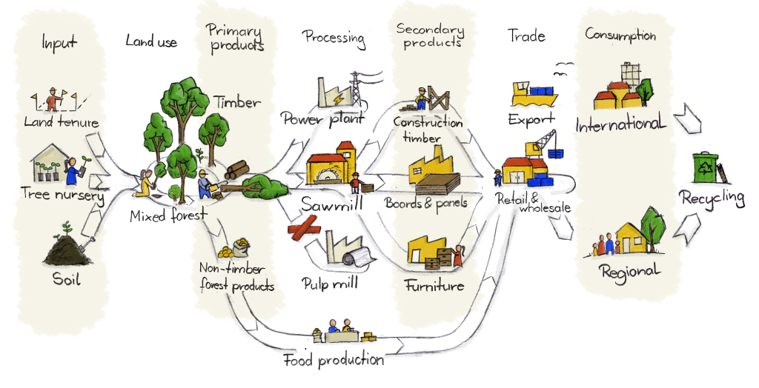
Value chain (1)

Slide 4
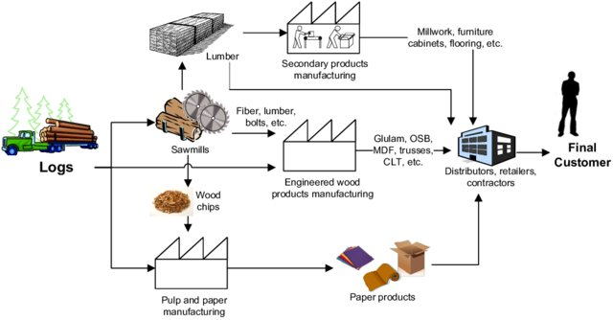
Value chain (2)

Slide 5
Value chain (3)
Product/Pro-duct group | Product owner | Product/Service value chain (ex.)
 |  | Conception | Product or service designer | Raw materials | Supply | Consulting | Production | Logistic | ..........
N1 | X1 | X1, X2, X3, X4, X5, X6 | X1, X2 | X1 | X3 | X4 | X1 | X1 | .......
N2 | X3 | X1, X2, X3, X4, X5, X6 | X2, X3 | X3, X6 | X3 | X4 | X3 | X2 | .......
N3 | X1 | X1, X2, X3, X4, X5, X6 | X1, X2 | X1, X2, X3 | X3 | X4 | X1 | X1 | ........
N4 | X6 | X1, X2, X3, X4, X5, X6 | X2, X6 | X5, X6 | X3 | X4 | X6 | X2 | .....
....... | ... | ... | ... | ... | ... | ... | ... | ... | .....
Nn | X1 | X1, X2, X3, X4, X5, X6 | X1, X2 | X1, X4 | X3 | X4 | X1 | X1 | .....
MTEPi
X1, X2, ..., Xn – klasterio nariai

Slide 6
Value chain(4)
X₈
I
N
C
O
M
E
X₁
X₁
Beverages
X₉
X₇
Functional Food for Athletes
X₂
Food
X₄
X₅
X₃
Supplements
X₆

Slide 7
Value chain (5)
X₈
X₁
I
N
C
O
M
E
X₉
X₇
RoboHard
Robotic Systems in Industry
X₂
X₆
X₅
RoboLight
X₃
X₄

Slide 8
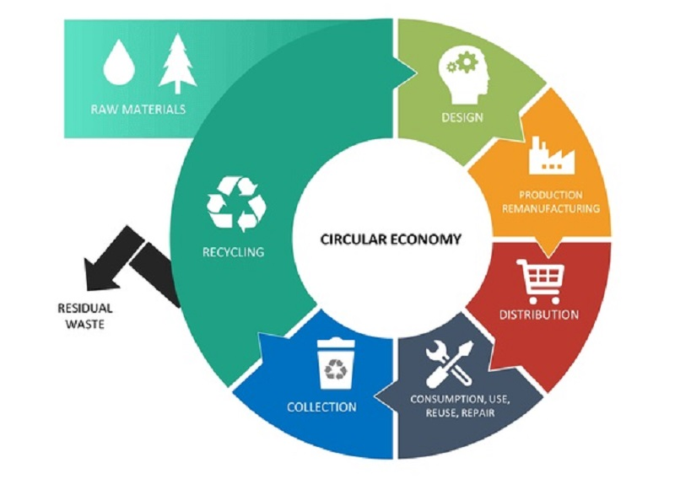
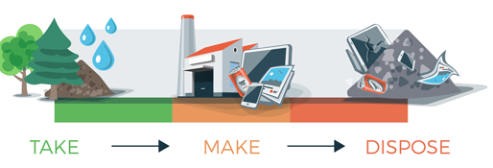
Value chain (6)
Notes:
Reikia tik desinio paveiksliuko

Slide 9
EU PRIORITIES 2030
Sectors:
Circular economy
MANUFACTURING
HEALTH
AGRICULTURE
ENERGETICS
Digitization

Slide 10
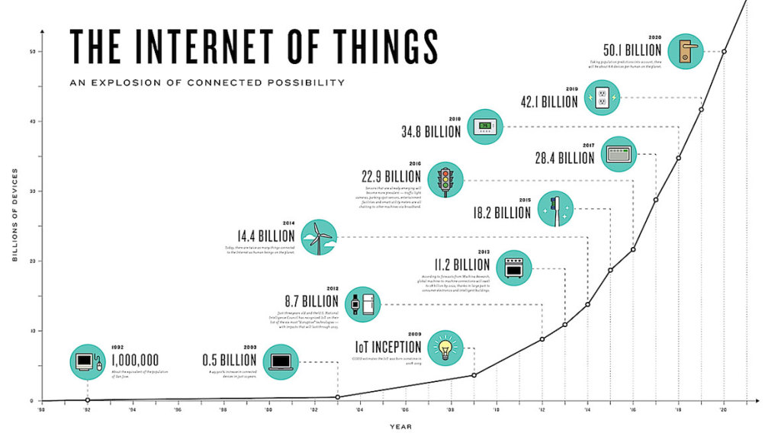

Industry 4.0
We are on the brink of revolution, which will change the way we live, work and communicate.
Humanity has so far experienced nothing similar to its fourth industrial revolution in size and complexity

Slide 11


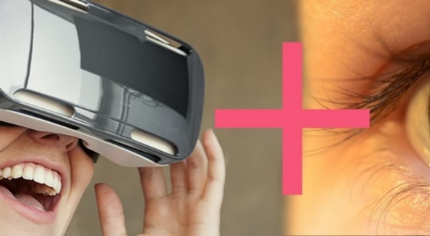
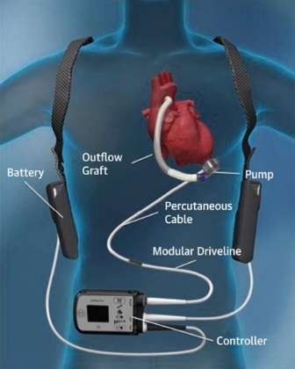
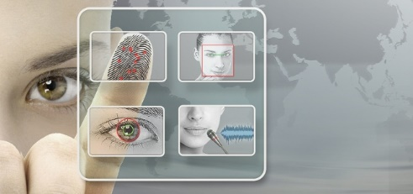
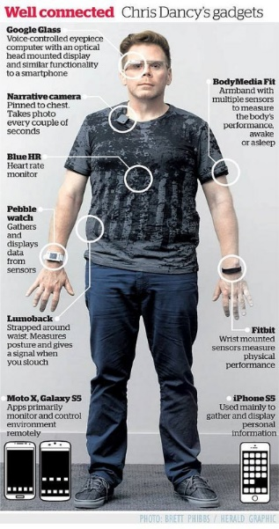
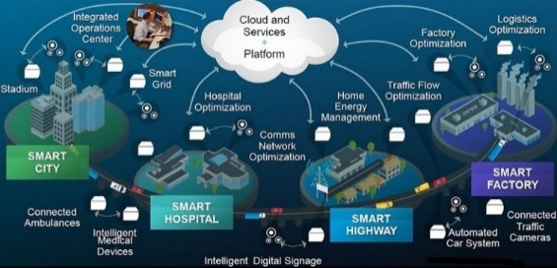

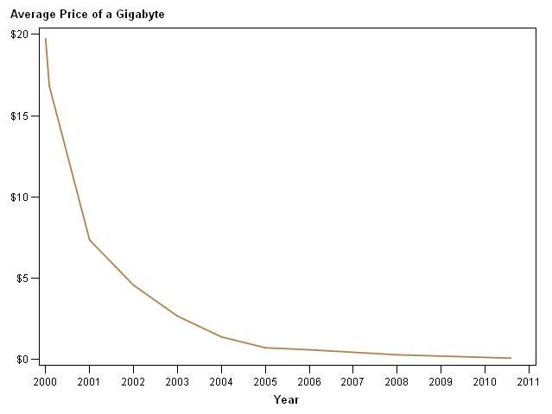
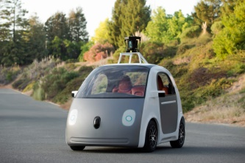
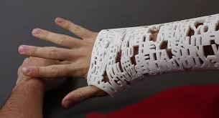
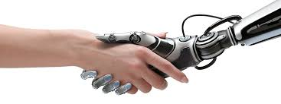
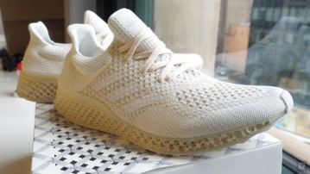
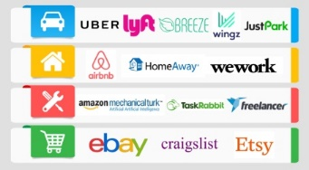
Industry 4.0: digitization technologies
VISION CONNECTION
IMPLANTATION TECHNOLOGIES
VIRTUAL REALITY
NEUROTECHNOLOGIES
Internet of Things
BIG DATA
DECISION MAKING
SUPER COMPUTER IN POCKET
SMART HOME
SELF-PROPELLED AUTOMOBILES
SMART CITIES
BIG DATA
ROBOTIC SERVICES,
HUMAN - MACHINE CONNECTION
PARTICIPATING ECONOMY
3D PRINTING
WORLD WIDE WEB IN CLOTHES
SOURCE: WORLD ECONOMIC FORUM, 2016

Slide 12
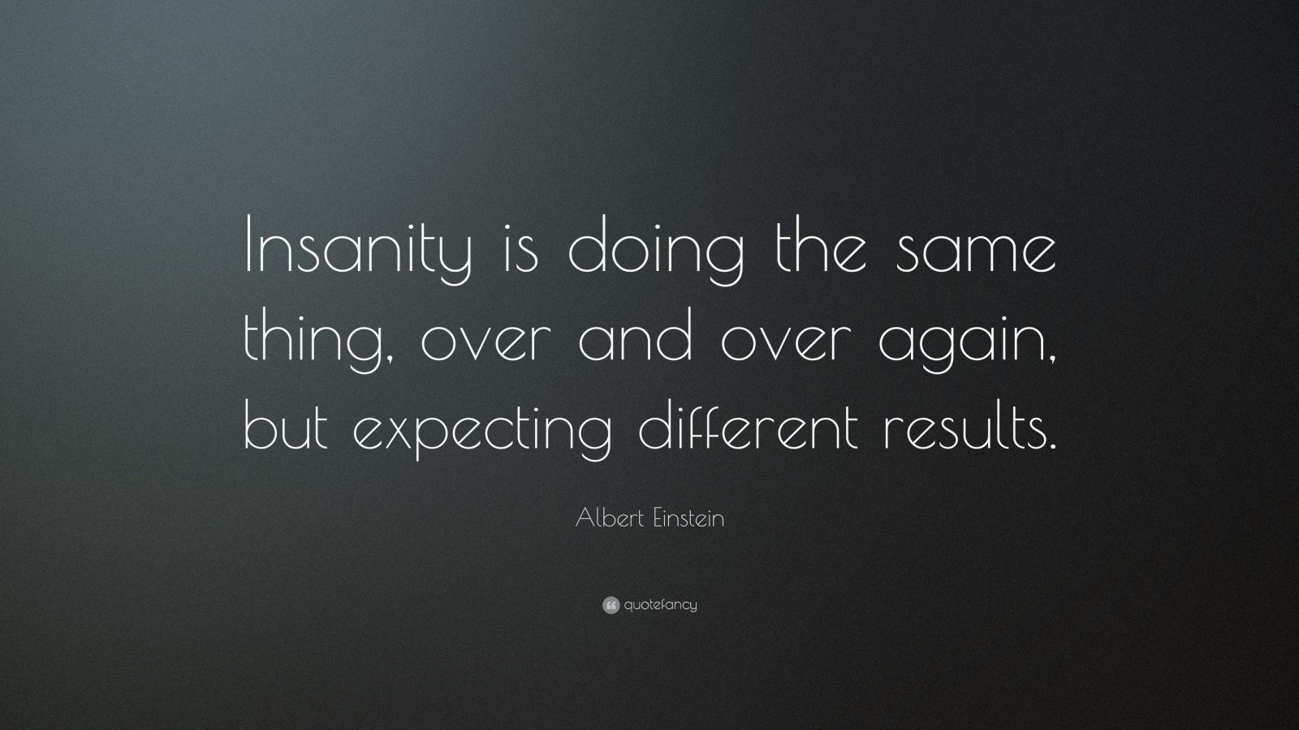
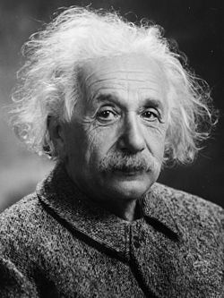
Insanity is doing the same thing, over and over again, but expecting different results.

Slide 13
Gytis Junevičius

